Slide 1
Majlis Ansarullah
Monthly Meeting
October 2017
This slide deck contains images licensed for the purpose of this presentation only.
No one is permitted to use the images for any other use, without prior permission.

Slide 2
AGENDA
Recitation of the Holy Quran (1:5-7)
Pledge
Reminders: Recitation of HQ and Congregational Prayers
Monthly topic: Do we understand the wisdom behind prayers and worship of God?
Health topic: Stroke
National Reminders/announcements
Local Reminders/announcements
Dua

Slide 3
It’s a blessing to do Waisyat!
Khalifatul Massih III (ra) said, "Through the Promised Messiah^{as}, Allah Almighty has established the system of Wasiyyat in Jama‘at Ahmadiyya. Wasiyyat is indeed a great institution in every aspect. The purpose of Wasiyyat is that among the members of the Ahmadiyya Movement, there should be a group which should fulfill its obligations in view of the teachings of Islam with such diligence and sacrifice that it should become clearly distinguishable from the others. Wasiyyat does not mean merely to sacrifice one tenth of one’s property. Rather it is a system which lifts man from the depths of the earth and elevates him to the heights of heaven.“
(Friday Sermon, April 30, 1982).

Slide 4
Why read the Holy Quran regularly?
Quran is the only book worth reading!
Had we not possessed the Holy Quran and only the Hadith collection had been there to base our faith and belief on them, we would not have been able to face the people of other faiths and we would have been very much ashamed of it. When I pondered over the word ‘Quran’ it dawned on me that this blessed word was very prophetic. The prophecy is that the only book worth reading is the Holy Quran, and time will come when other books will also be there but this will be only book worth reading and it is only through this book that the honor of Islam will be retrieved and the falsehood will be eradicated ; all other books will be deserve to be put aside.
(Malfoozat Vol II, page 132)

Slide 5
Watching Our Congregational Salat!
Home Can be a Place for Congregational Prayers
Hazrat Muṣleḥ Mau‘ūd (RA) wrote, “Should someone fail to find a companion to accompany him for congregation, he can arrange for congregation at home leading the prayers while his wife and children stand behind him. This will at least keep the habit of offering prayers in congregation alive. A day will come that God will make that single person into a full-fledged Jama‘at.
(Page 117, Blessings of Khilafat by Hazrat Muṣleḥ Mau‘ūd (RA)

Slide 6
Do we understand the wisdom behind prayers and worship of God?

Slide 7



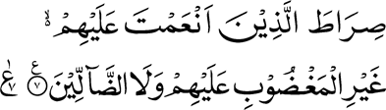
Click to listen the recitation
[1:5] Thee alone do we worship and Thee alone do we implore for help.
[1:6] Guide us in the right path —
[1:7] The path of those on whom
Thou hast bestowed Thy blessings, those who have not incurred Thy displeasure, and those who have not gone astray

Slide 8
What is the wisdom behind this prayer taught in the first chapter of the Holy Quran?
Share your thoughts

Slide 9
Guidance from the Promised Messiah (as)
Acceptance of prayer is proved by valid instances as part of the law of nature and God sets up living models in every age. That is why He has taught the prayer: Guide us along the straight path, the path of those on whom Thou hast bestowed Thy favors. This is the design and law of God and no one can alter it. Guide us along the straight path is a supplication for perfection in conduct. In form this is a direction to seek guidance to the straight path, but it is preceded by: We worship Thee alone and beg Thy help. This indicates that we must use our natural capacities for treading along the straight path and seek Divine help in the process. Therefore, appropriate available means must be employed. On who neglects this is guilty of ingratitude in respect of God's bounties.
Be mindful, then, that if we fail to use these powers and faculties, our prayer is vain. If we do not use the gifts we possess, how can we supplicate for more? That is why: We worship Thee alone, precedes: Guide us along the straight path. This is an affirmation that we have not left unemployed and stultified the gifts and faculties that Allah has granted us.
(Al-Hakam, Dec. 10, 1901)

Slide 10
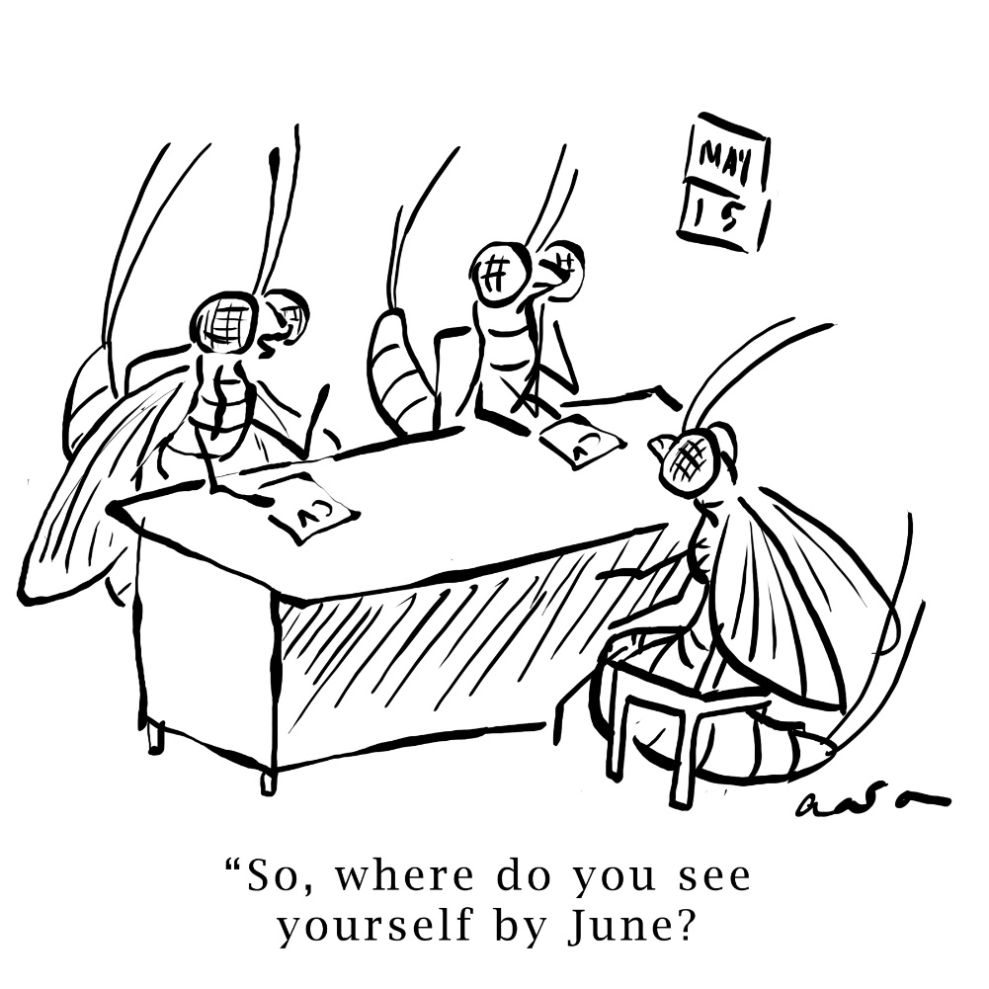
Discussion I
You are now 20 years into your career. For the next 5-7 years, if you put in the extra time and weekends, you can land an executive position at your firm. Besides securing your own personal finances for the future of your family, this could also help you serve the Jama’at further. The financial payout would significantly increase your Chanda payments and the prestige of the position can paint an even better image of the Jama’at.

Slide 11
  What’s the best approach?
  Option 1: The overall benefits of working this hard in the career are worth the time sacrifice.
  Option 2: This will impact your ability to serve the Jama’at and spend adequate time with the family.
  Option 3: This will lead you down a path of worldliness.
  Option 4: any other response

Slide 12
Guidance from the Promised Messiah (as)
The real purpose of all the external and internal limbs and faculties that have been bestowed on man is understanding and worship and love of God. That is why, despite a thousand occupations, man does not find his true well being except in God Almighty. Having acquired great wealth, or achieved high office, or having become a great merchant, or having acquired governing authority, or become a great philosopher, he departs in the end from these worldly involvements with a sense of frustration. His heart rebukes him all the time about his deep concern with the world and his conscience never approves his wiles and deceits and wrongful actions.
Ruhani Khazain Vol. 10, p. 100

Slide 13
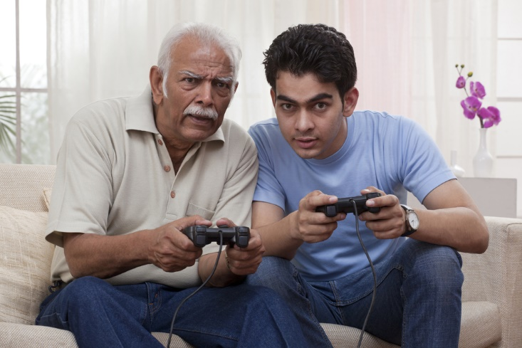
Discussion II
You are most regular in your spiritual obligations (Salat, reading Holy Quran, Sadqa and Chanda). You get great joy in reading the books of the Promised Messiah (as) and are committed to reading them all before you leave this world. You have come to a
point in your spiritual journey that you don’t enjoy TV shows, playing games with grandchildren, or even mingling with other family members. You sometimes feel guilty about this.

Slide 14
  What’s the best approach?
  Option 1: Don’t feel guilty. Do as your heart desires.
  Option 2: Your family has its rights too. You should devote time towards the things they enjoy.
  Option 3: Talk to your family about spiritual matters and focus your time with them on telling them about what has inspired you.
  Option 4: any other response.

Slide 15
Guidance from Promised Messiah (as)
The purpose of the creation of a thing is determined by its highest achievement beyond which its faculties cannot rise. For instance, the highest a bullock is capable of is plowing, or irrigation, or transportation, and therefore these are the purpose of its life and it cannot rise above them. But when we take stock of man's faculties and powers to discover his highest capacity, we find that he is invested with the faculty of seeking after God so much so that he desires that he should become so devoted to God's love that he should have nothing of his own and that everything should become God's. He shares his natural needs like food and drink and rest with other animates, and in industry some animals are ahead of him; for instance, the bees produce such excellent honey from every type of flower that man has so far not been able to compete with them. It is clear, therefore, that the highest capacity of man is meeting with God Almighty and thus the true purpose of his life is that the window of his heart should open towards God.
Ruhani Khazain Vol. 10, p. 100

Slide 16

Discussion III
It is the start of Majlis Ansarullah year and you approach, Tariq, a fellow nasir, about paying a portion of his Ansar Chanda. He then confides in you his frustrations with paying Chanda. He says that he always pays regularly (which is true), but feels that he is continually being met with financial crisis. He recently lost his job and is now working odd jobs to make ends meet. Ever since you’ve known him, he has struggled. Tariq now questions whether the promises of the Holy Quran about giving in the way of Allah are really true. What is your response to him?

Slide 17
  What’s the best approach?
  Option 1: Don’t ask for Ansar Chanda from Tariq again until he gets a permanent job.
  Option 2: Remind Tariq that his health is good and his family is strong, so take these trials in stride.
  Option 3: Warn Tariq about these ill feelings and tell him to offer istaghfar. He should maintain paying Chanda based on his current income.
  Option 4: Another option?

Slide 18
Guidance from the Promised Messiah (as)
A question is raised that God Almighty being Gracious and Benevolent, His direction that man should worship Him is for the benefit of man and not that it adds in any way to God's honour. It is true that through the worship of God man's own welfare is intended, yet the Rabubiyyat of God Almighty demands that avoiding evil and devoting himself to His worship and obedience, he should achieve his good fortune. If he does not wish to follow that path His wrath is aroused not for His own sake, but for his sake and He subjects him to diverse types of warnings and admonitions. If he still does not take heed, he is consumed in the fire of rejection and of despair. It is not permissible that anyone should say to Him: Why do You bother about what would harm me or benefit me? Why do You admonish us and send revealed Books and punish us?
Ruhani Khazain, Volume 2, pp. 215

Slide 19
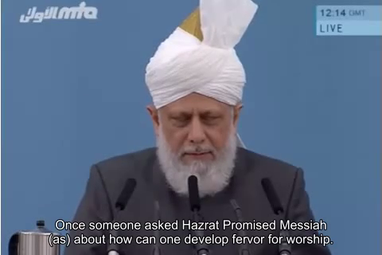
A Short Video from Friday Sermon, Oct. 25, 2015

Slide 20
Translation of the Video
Once someone asked Hazrat Promised Messiah (as) about how can one develop fervor for worship. [The Promised Messiah (as)] replied that fervor in pious deeds and worship cannot be attained by itself. It is not possible that a man can create it by himself or by his own efforts. [Instead], it is attained by the Grace and Will of God. To attain this, it is important that a person doesn’t become anxious and continues to pray to God to grant him the ability [to do so] and for His Grace. He shouldn’t get tired and consistently pray for it. He said that one should not become tired and not give up these prayers. When a person remains consistent in [prayers], then ultimately God, by His Grace, creates a state in him for which his heart yearns and craves. That is, a fervency and zeal for worship is created. A sense of sweetness and pleasure for worship is generated. He said but if someone doesn’t strive and struggle enough and thinks that it can happen automatically and he can come close to Allah or develop a love for worship as if someone would magically turn him into a worshipper, then it is not possible. He said, that this is not the principle nor the practice of Allah. He then said, that whomever tires God in this manner, he ridicules God and is destroyed. The result of this is nothing but [spiritual] destruction and he goes away from God. He said that firmly remember that one’s heart is in God’s hand and without His Grace one can become a Christian the very next day and turn away from Islam, or indulge in some other nonreligious act, turning away from religion. Therefore, always keep praying for His [God] Grace, and beseech for His help, so that He keeps you on the right path.

Slide 21
Where do we stand?
اپنے جائزے لیں
Self analyze yourself, KMV
During the past month,
How many times did you enjoy praying to Allah?
How many times did you confidently share with your family that Allah Ta’ala listens to prayers?
How many times did your heart reject a news item you read on the internet or in a newspaper or a magazine raising doubts about existence of God and trust in Him.
Add the three numbers together.
(Keep it to yourself.. the “score” is for you!)

Slide 22
How to Improve?
اپنے اندر پاک تبدیلیاں پیدا کریں
Bring about pious changes in yourself
0-1
Combined Score
>10
Strive hard and pray for wisdom to experience God in your heart. Keep struggling and continue to do good
Keep striving and praying to continue to increase in your wisdom to experience and trust in God
Keep enhancing your trust in Allah and pray for more and more wisdom to increase your trust and inspire your family

Slide 23
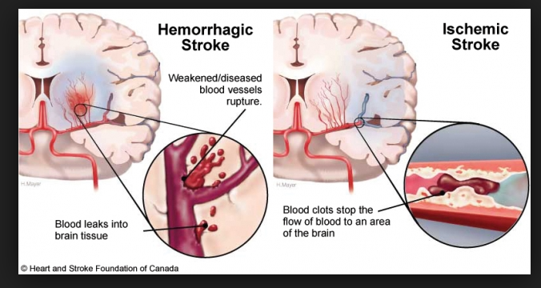
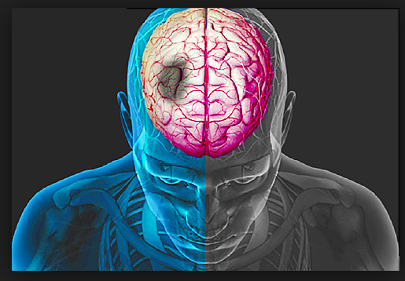
Health Topic: Stroke

Slide 24

What is Stroke ?
Stroke occurs when the supply of blood to the brain is either interrupted or reduced. When this happens, the brain does not get enough oxygen or nutrients which causes brain cells to die
There are three main kinds of stroke; ischemic, hemorrhagic and TIA
More than 2/3 of survivors will have some type of disability. Some patients recover completely
Every 4 minutes someone dies from stroke
Stroke is the leading cause of adult disability in the U.S.
Up to 80 percent of strokes can be prevented

Slide 25
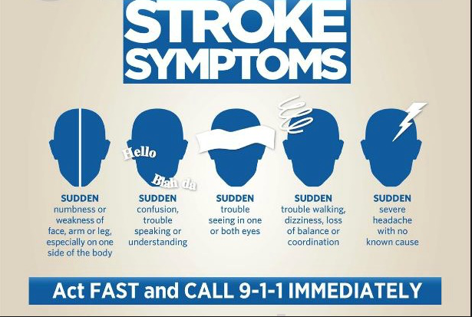
Stroke Symptoms

Slide 26
How to Prevent & Treat Stroke?
STROKE PREVENTION
Balanced diet and regular exercise
Maintain a healthy weight
Keep blood pressure and diabetes under control
Treat obstructive sleep apnea (if present)
Treatment of irregular heart rhythms
Say no to alcohol, tobacco and drugs
Anti-coagulant and anti-platelet medication
Surgery to restore blood circulation
STROKE TREATMENT
May include clot-busting drugs called (TPA)
Aspirin or other blood thinners
Physical Therapy
Occupational Therapy
Speech Therapy, Surgery and Support groups

Slide 27
Four Priorities for 2017
At least 50% of Tajnid to attend monthly meetings where we discuss Huzoor’s vision: “Save yourself and your families from a fire” in interactive discussions.
Bring 350+ new Ansar in Nazam-e-Wasiyat (The targets for small, medium and Large Majlis are 3, 5, and 7, respectively)
Help establish a culture of congregational Salat.
More than 50% Tajnid to attend National Ijtima.

Slide 28
Local Reminders
Dua

